Slide 1
Knowledge Graph for Machine Learning
Timon Zimmermann, Rhicheek Petra
Oracle Labs
Mar, 2019

Slide 2
Overview
1) Background & Problem Statement
2) Healthcare Dataset & Application
3) Baseline: Architecture & Application
4) KG-RNN: Architecture & Application
5) Results
6) Concluding Remarks

Slide 3
Background & Problem Statement

Slide 4
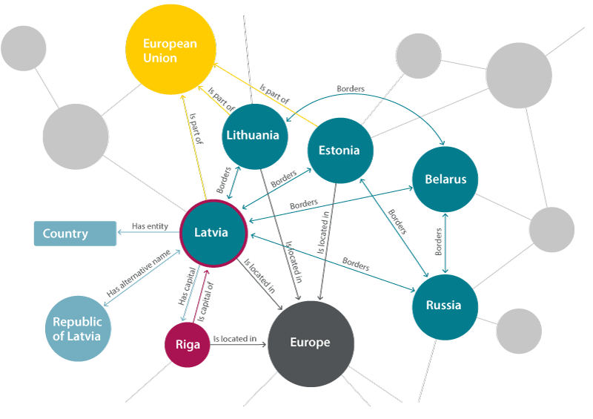
Knowledge Graph
Represent information as entities, properties and relations between entities
Allows to naturally combine information from different sources
Lot of activity and research around leveraging knowledge graphs in Machine Learning

Slide 5

Recurrent Neural Network
Allows to exploit the temporal dynamic behavior of a sequence
Use-Case Examples
Stock Market Prediction
Machine Translation

Slide 6
Machine Learning on Evolving Knowledge Graph
How to learn from knowledge graph with a dynamic component?
Changing Knowledge Graph structure over time
Dynamic properties in entities
Idea: Feed evolving entity to a Machine Learning model as a sequence of entity states
Solution: Fusion of Graph Machine Learning and Recurrent Neural Network

Slide 7
Evolving Knowledge Graph – Example Online shop
Entities and Properties:
Client (First name, Last name)
Category (Name)
Product (Name, Price, Properties)
Relationships:
Client – purchased – Product
Client – follows – Category
Product – belongs to – Category
Product – shares property – Product
Product – has similar price – Product

Slide 8
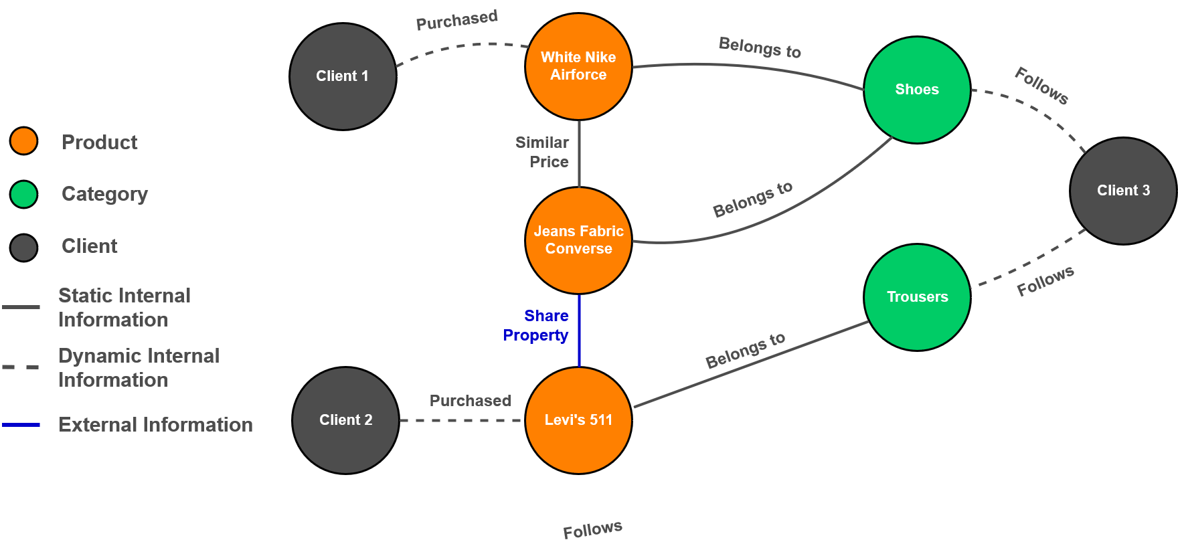
Evolving Knowledge Graph – Example Online shop

Slide 9
Healthcare Application
Dataset

Slide 10
Healthcare Dataset – Admission Point-of-View
4 kinds of event over time:
Fluids into patient
Fluids out of the patient
Lab test results
Drugs prescribed
Medical codes (ICD-9) describing the diagnoses and procedures at discharge
Examples:
Insulin, 5 ml/h
Urine, 3ml at 10:30
pH, 7.4 at 15:35
Aspirin, 500mg/day
ICD-9 Codes:
401.0: Malignant essential hypertension
403.9: Unspecified hypertensive renal disease
…

Slide 11
Machine Learning in Healthcare
Problem:
Analyzing thousands of events over time is very difficult for physicians:
Humans can only process and correlate 4 variables at the same time
Historical information from previous admissions of other patients 12 years ago, potentially at other locations
Goal:
Predict the medical codes that will be diagnosed at discharge of the patient

Slide 12
MIMIC-III
Dataset: MIMIC-III, v1.4
MIMIC is a relational database containing data of patients who stayed within the intensive care units at Beth Israel Deaconess Medical Center
Commonly found in the scientific research & literature
46’520 patients
58’976 admissions
21’000’000 input events
4’500’000 output events
28’000’000 lab tests
4’000’000 prescriptions
Input
We consider admissions as our main entity composed of many events
Output
Multi-label multi-class classification problem:
- ~ 8’900 unique ICD-9 codes in total
- We focus on the 50 most frequent ones

Slide 13
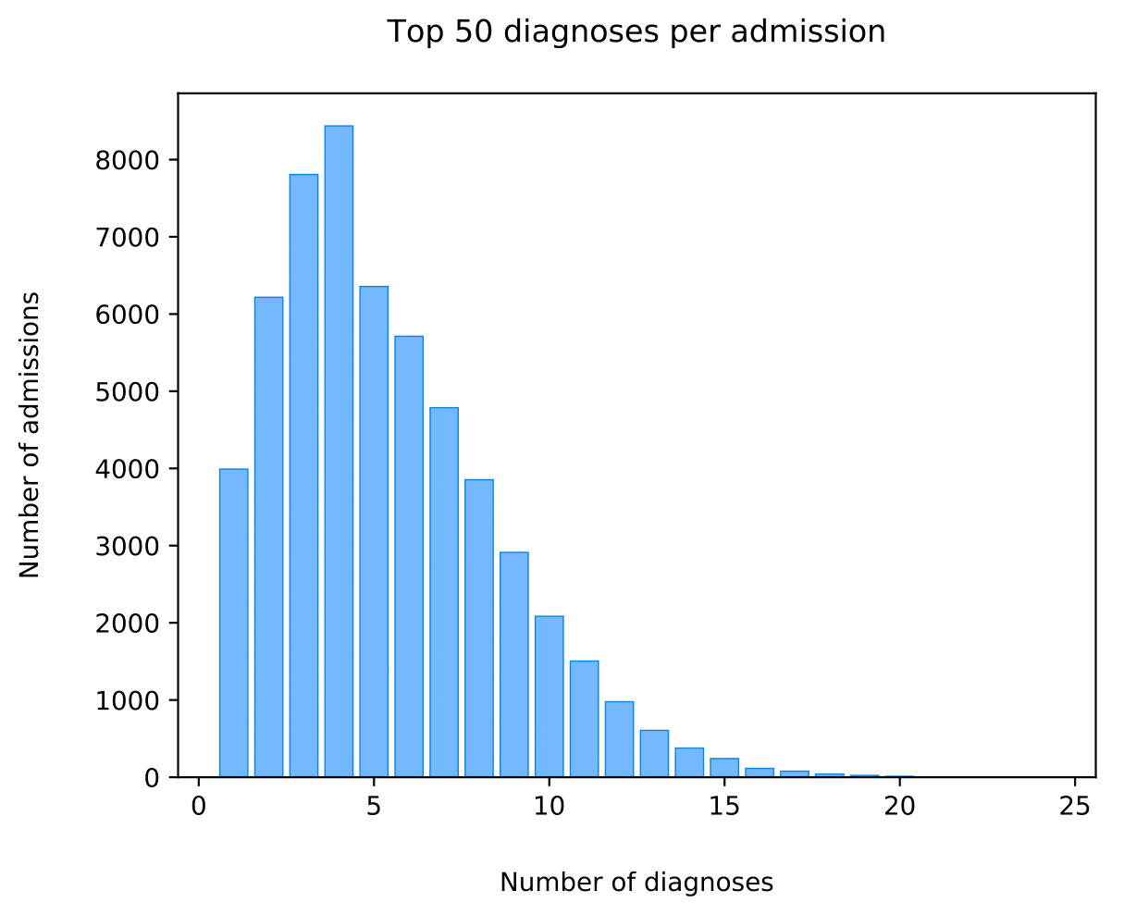
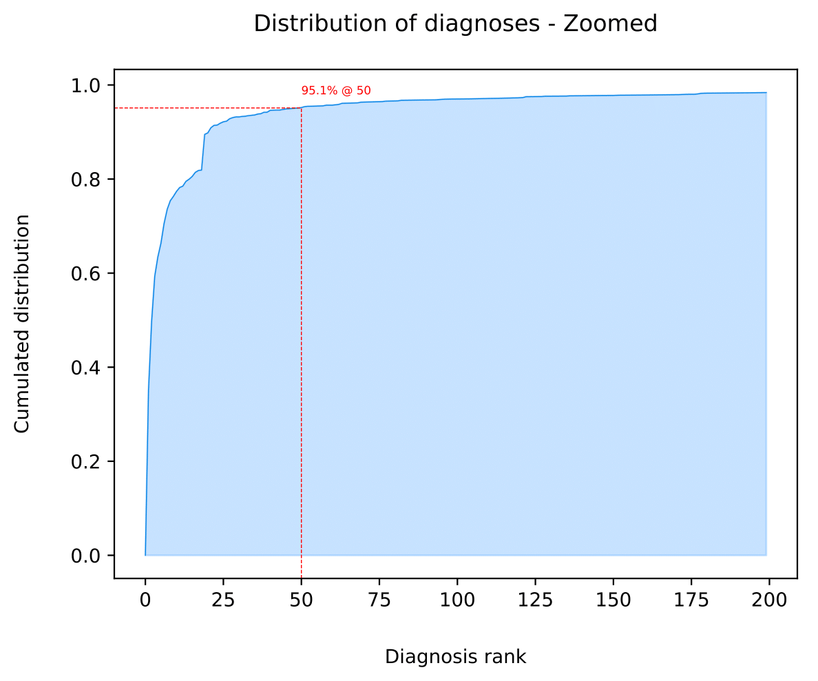
MIMIC-III – Statistics

Slide 14
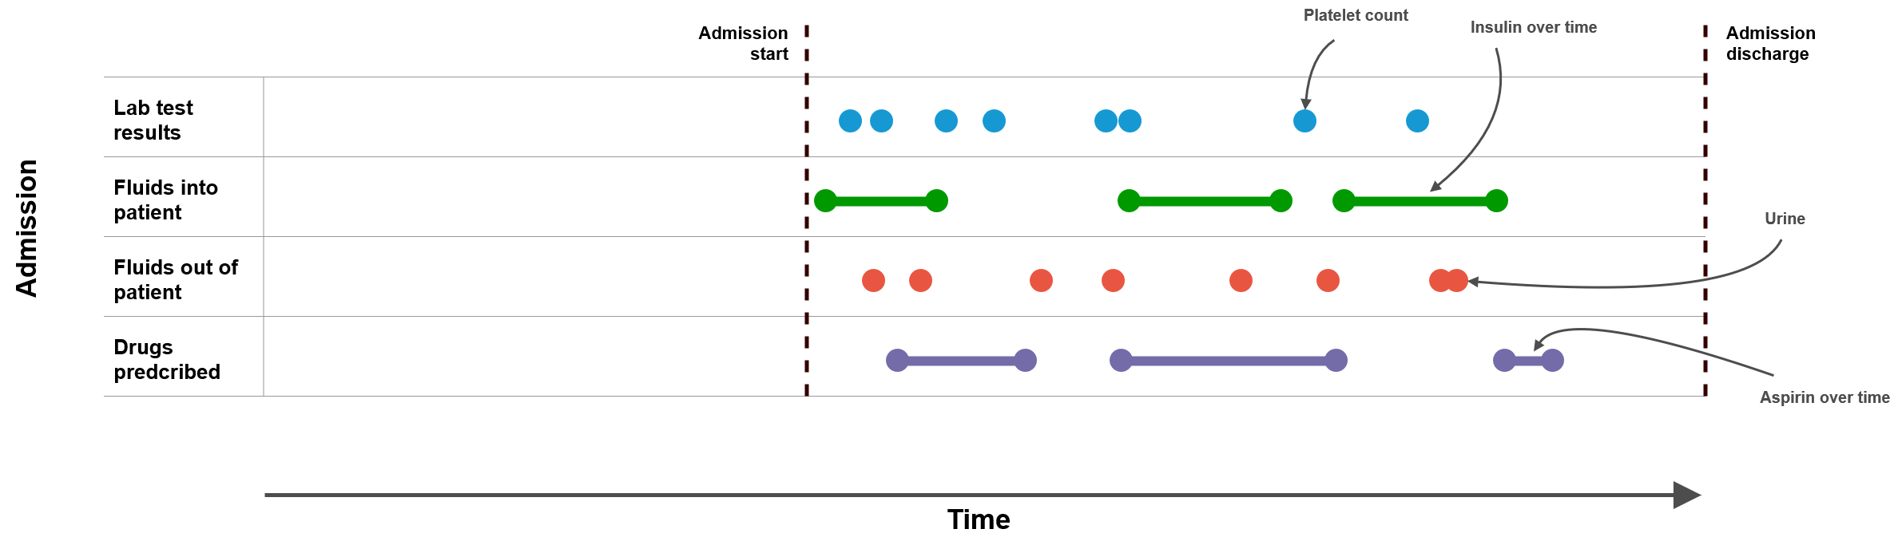
MIMIC-III – Data Formation – Original

Slide 15
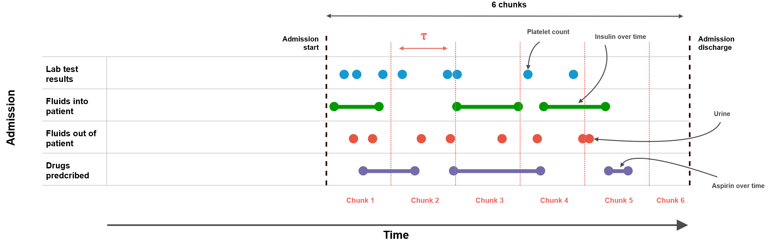
MIMIC-III – Data Formation – Step 1
Modifications
Group events in same time interval (e.g. 3h)
Consider each interval as a graph state or chunk

Slide 16
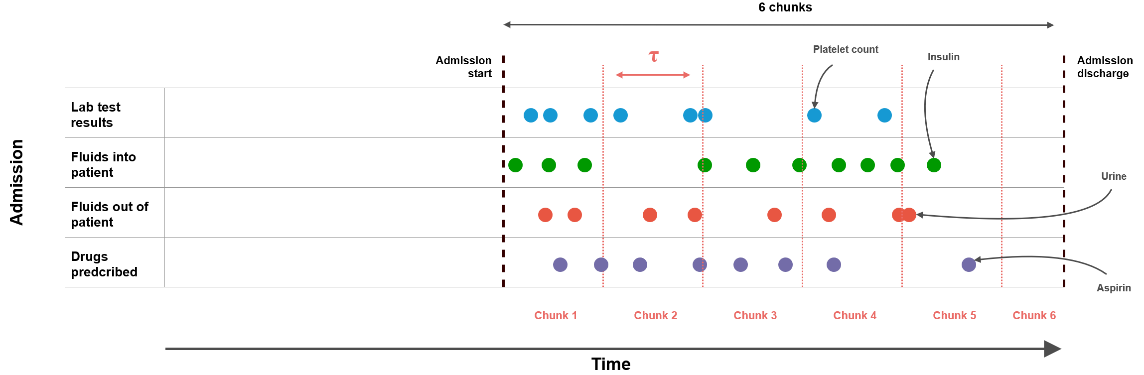
MIMIC-III – Data Formation – Step 2
Modifications
Conversion of time-range events to one-time events
For the same event, convert all units to same one

Slide 17
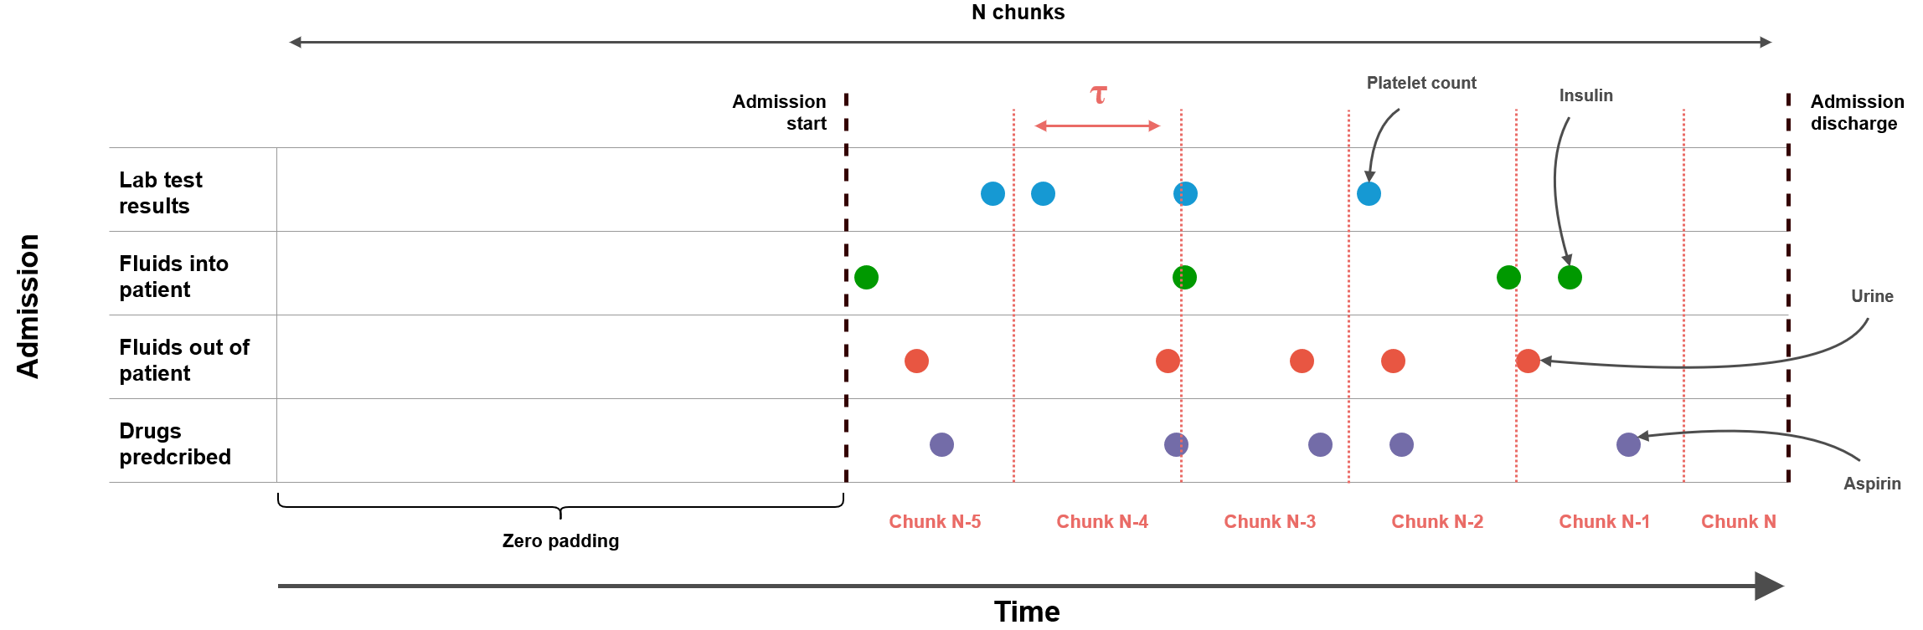
MIMIC-III – Data Formation – Step 3
Modifications
Down-sample events per type and per chunk to some fixed number (K)
Add zeros before admission’s beginning to make it fixed length (N)

Slide 18
From MIMIC-III to an Evolving Graph
We now have an evolving entity for each admission
Solves many challenges inherent to healthcare:
Many missing values in events
Non-constant intervals among different events:
mmHg/h for blood pressure
mg/30min for aspirin
More natural than existing approaches:
We are interested in the evolution of a patient’s state
Not his exact vitals at every T, where T is the finest-grain event interval

Slide 19
Baseline
Single admission approach

Slide 20
Baseline
Main idea
Create a vector representation of each event (called embedding)
Aggregate events of the same type within the same chunk together
Concatenate aggregated events for each type
Feed aggregated chunks into a Recurrent Neural Network
Predict the final diagnoses from the output of the RNN

Slide 21
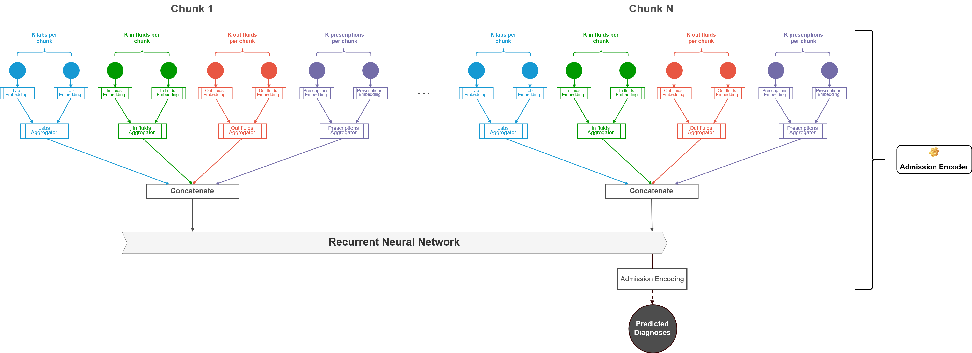

Slide 23
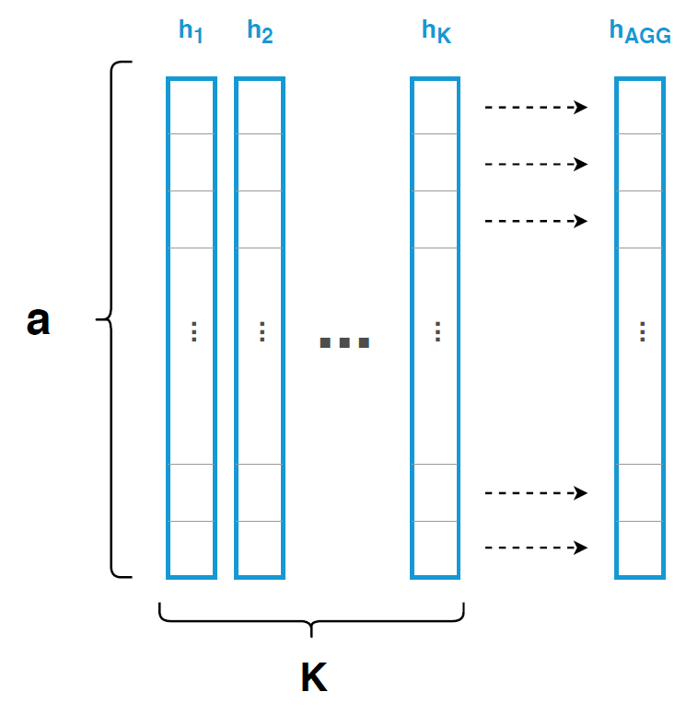
Baseline
Details
Initialize events to a multi-dimensional embedding vector:
Aspirin → eAspirin = [e1, e2, e3, …, V]
V is the associated value
eAspirin is a vector of length a
Aggregators of events (K) of the same type within the same chunk
Sum-pooling
Mean-pooling
Max-pooling

Slide 24
KG-RNN: Architecture
Multi admission approach

Slide 25





Weighted Knowledge Graph Construction
From tables and external information
Entities at t = 0
Entities at t = T
ID | Type | Property A
1 | Entity A | 1
2 | Entity A | 5
3 | Entity B | 0
4 | Entity C | 2
ID | Type | Property A
1 | Entity A | 29
2 | Entity A | 3
3 | Entity B | 7
4 | Entity C | 12
Files
Databases
Relations
1
2
Entity 1 | Entity 2 | Type | Weight
1 | 3 | X | 0.95
3 | 2 | Y | 0.5
4 | 1 | X | 1
3
4

Slide 26
Weighted Knowledge Graph Extraction
From this Knowledge Graph:
Extract the M nearest neighbors for each input entity
Nearest: Can be any distance metric between entities
Any graph sampling technique can be applied (weighted or not):
Random sampling
Snow-Ball sampling
Forest Fire sampling
…

Slide 27
KG-RNN
Main idea
Feed graph states sequence, focused on an entity, through the Encoder module (c.f. Baseline):
Input entity
Neighboring entities
Gather the encoded entities with the Main (c.f. next slides) module
Attach static information of entities to their encoding vector
Get the final prediction from these static information + encoding vectors

Slide 28
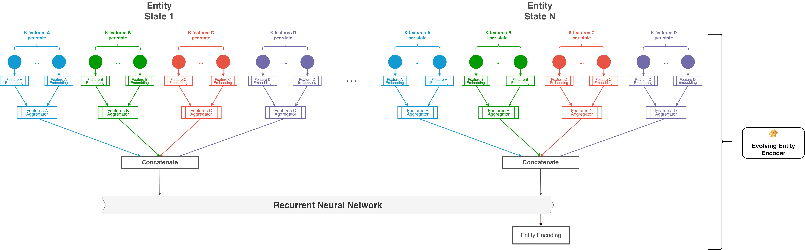
KG-RNN: Entity Encoder
Predicting from graph states

Slide 29
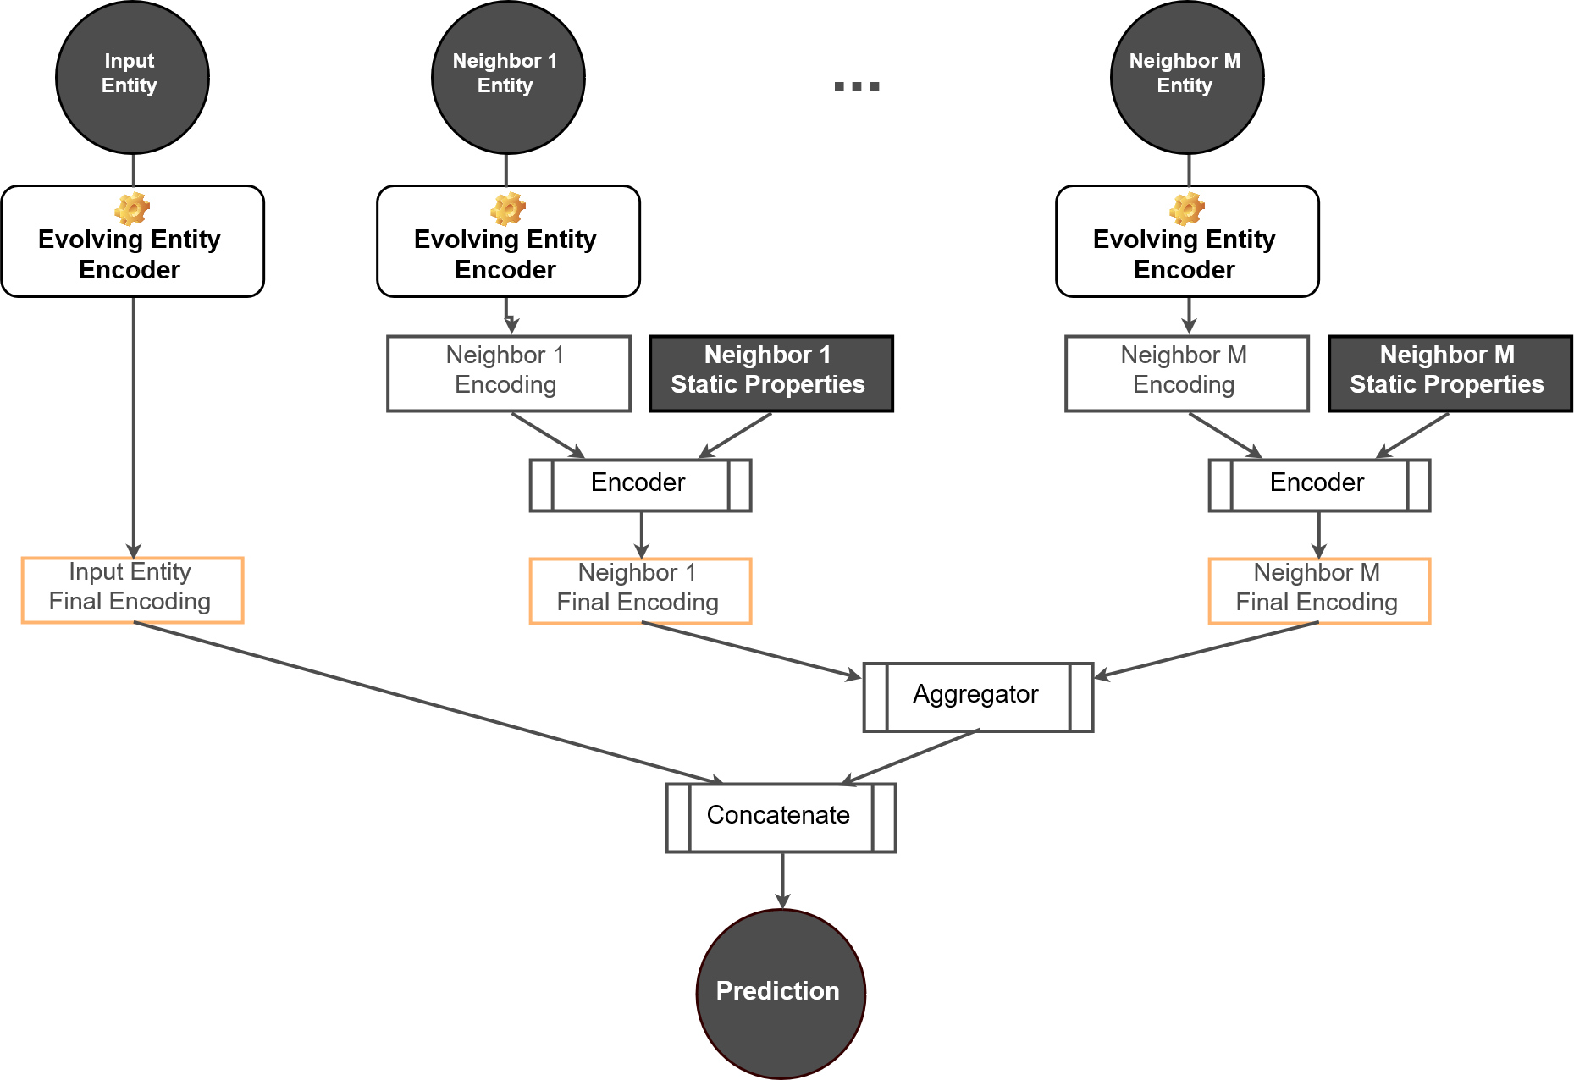
KG-RNN: Main
Predicting from graph states

Slide 30
KG-RNN: Application
Healthcare Dataset

Slide 31
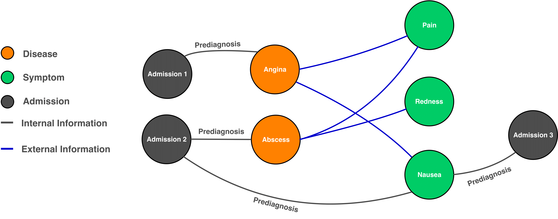
Weighted Knowledge Graph Construction
Healthcare example

Slide 32
Weighted Knowledge Graph Construction
Healthcare example
External information from derived Knowledge Graph:
Learning a Health Knowledge Graph from Electronic Medical Records (Rotmensch et al., Nature 2017)
They link diseases and symptoms:
Migraine – Headache (0.384), nausea (0.316), sensitivity to light (0.223), …
Each link comes with a relevance score → Edge weight
String matching between Internal KG and External KG:
NGrams + TF-IDF → Cosine similarity
Admission Prediagnosis – Disease
Admission Prediagnosis – Symptom
Cosine similarity score between 0 and 1 → Edge weight

Slide 33
Weighted Knowledge Graph Extraction
Healthcare example
Input entity: Admission
We extract 10 nearest neighbors per admission
Distance metric:
Disease – Symptom: Weight already defined in external KG
Admission – Symptom/Disease: Cosine similarity score between texts
Sampling: Importance Sampling
Compute Weighted Personalized PageRank score focused on input admission
Take top-10 admissions with respect to WPPR score

Slide 34
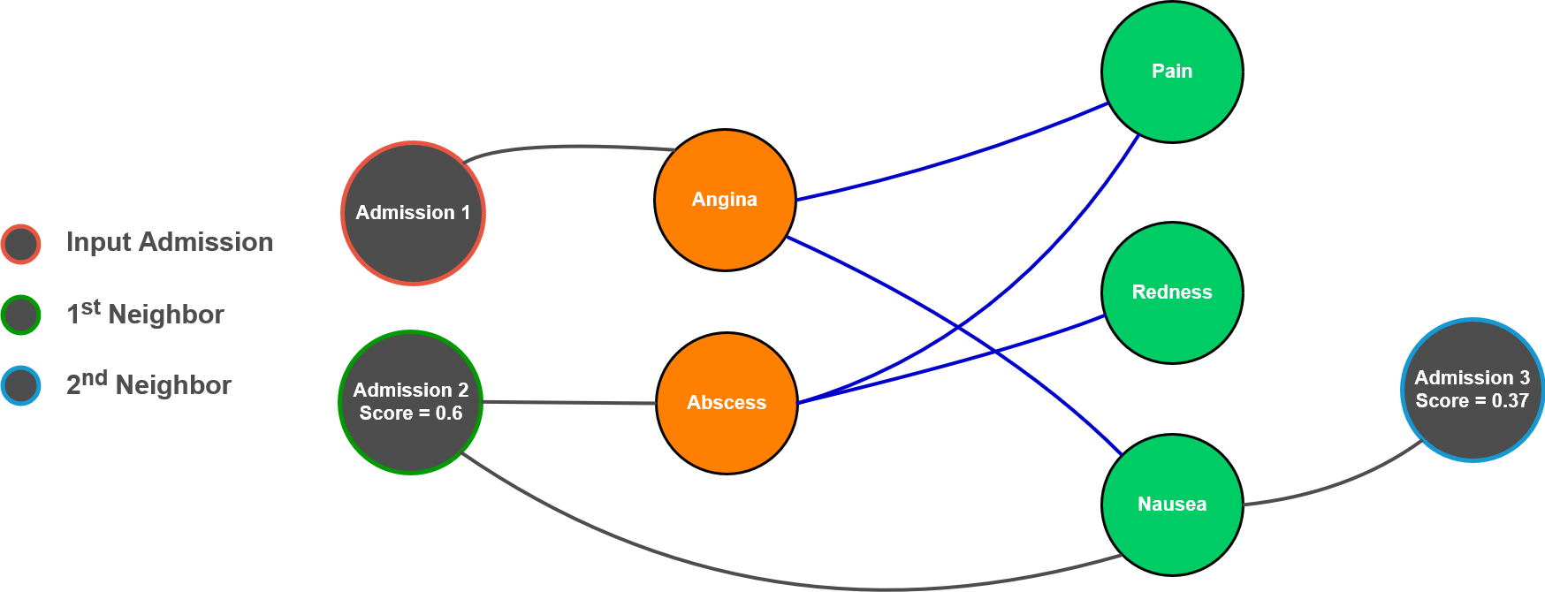
Weighted Knowledge Graph Construction
Healthcare example

Slide 35
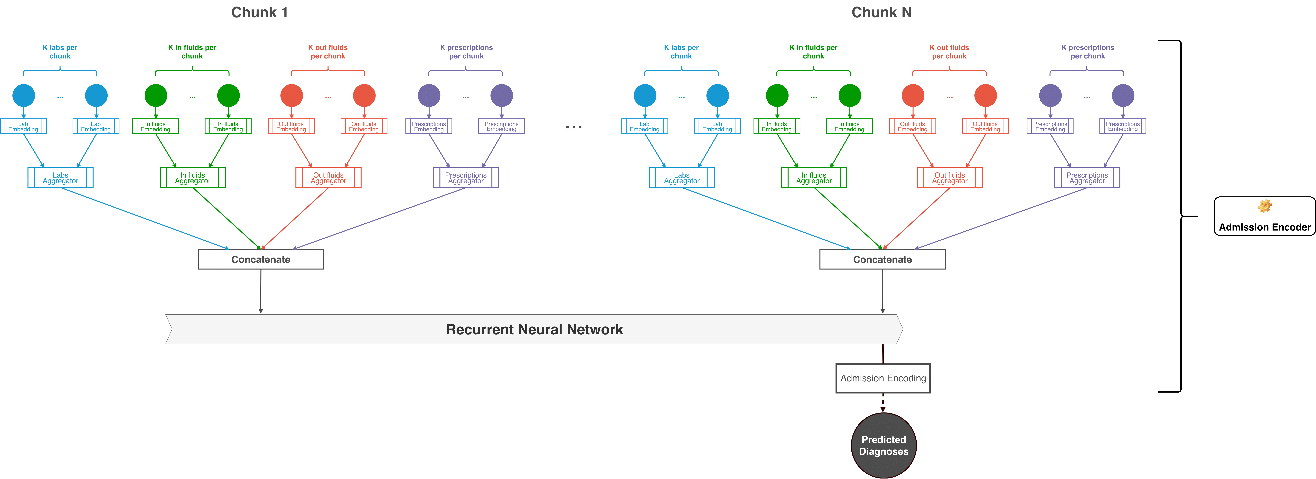
KG-RNN: Entity Encoder, reminder
Predicting from graph states

Slide 36
KG-RNN: General Model
Predicting from graph states

Slide 37
KG-RNN: Adapted Model
Predicting from graph states

Slide 38
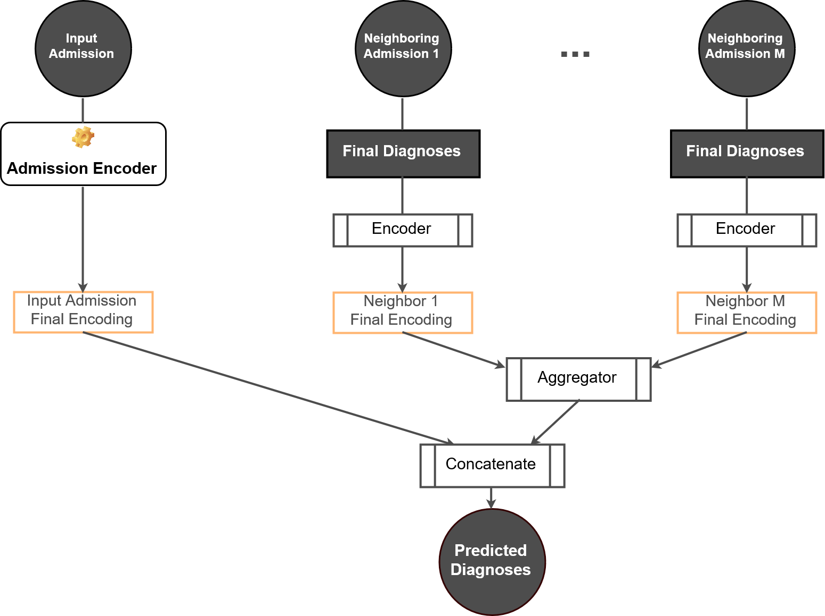
KG-RNN: Adapted Model
Predicting from graph states

Slide 39
Demo
Live Prediction Example

Slide 40
Results
Baseline vs. KG-RNN

Slide 41
Quantitative Results
Metric | Average | Model | Score
F1 | Macro | Baseline | 36.52%
 |  | KG-RNN | 37.90% (+1.38%)
 | Micro | Baseline | 51.55%
 |  | KG-RNN | 53.47% (+1.92%)
AUROC | Macro | Baseline | 85.24%
 |  | KG-RNN | 86.29% (+1.05%)
 | Micro | Baseline | 90.55%
 |  | KG-RNN | 91.03% (+0.48%)
Accuracy | - | Baseline | 92.22%
 |  | KG-RNN | 92.36% (+0.14%)
Properties
3 hours per chunk 200 chunks per admission
25 events per type and per chunk 10 neighbors sampled per input admission

Slide 42
Qualitative Results
After training, check the closest events to a particular event in terms of embedding vectors:
Neighbors for White Blood Cells
Neighbors for Sodium
Rank | Laboratory measure
1 | WBC Alternative name
3 | White Cells Alternative name
6 | Immunoglobulin A Antibodies produced by white blood cells
Rank | Prescription
1 | Sodium Chloride Nasal Related prescription
2 | Sodium Chloride 0.9% Flush Related prescription
5 | Famotidine Often given in “Sodium Chloride 0.9%“

Slide 43
Qualitative Results
Take-Home Message
→ KG-RNN not only learned similar events but also intrinsically linked and correlated events

Slide 44
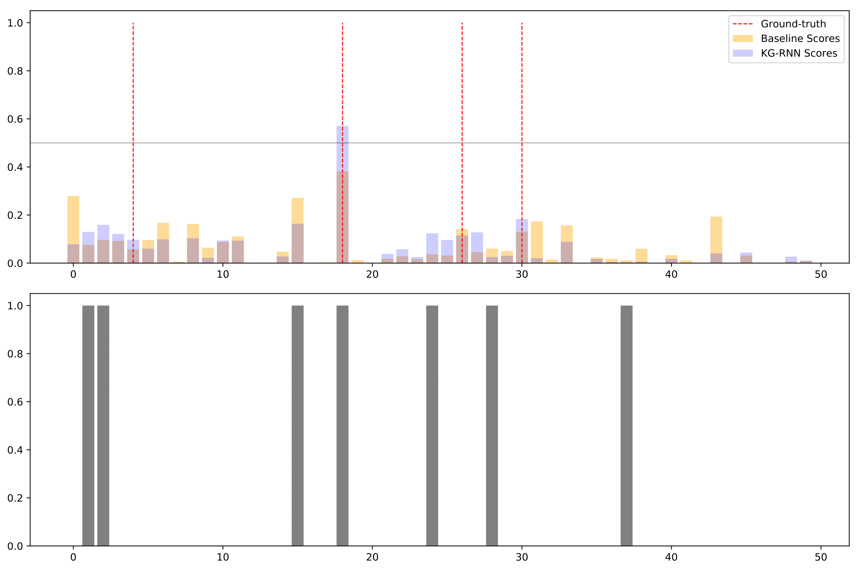
Qualitative Results
Baseline does not detect any diagnosis
Neighbor helped pushing the confidence of KG-RNN upward for 2nd diagnosis
Reveals how much KG-RNN relies on its neighbors

Slide 45
Concluding Remarks

Slide 46
Conclusion
Proposed a novel architecture and pipeline for processing evolving knowledge graphs
Our enriched knowledge graph has been designed to naturally cope with many of the challenges inherent to our application
Our solution shows significant improvement over a simple single-admission setting
Qualitative analysis revealing interesting findings in learning behavior

Slide 47
Potential Improvements
Neighbors Weighting
Account for neighbor importance using WPPR score as a coefficient
Events sampler
Down-sample events with respect to their importance instead of randomly
Chunks Overlap
Overlapping patient states may convey more information than disjoint ones
ICD9 Hierarchy
ICD9 codes are not equally distant to each other
Information should be used in the loss function & neighbors final diagnoses

